Slide 1



Swire Demand Analysis
Group 1
Louis Ackumey | Gustav Vollo | Shane Nisley | Aiden Coutin

Slide 2

Introduction
Develop a predictive model to accurately forecast demand for Swire’s limited-release products

Slide 3
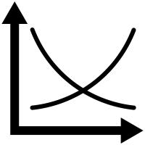
Introduction
Develop a predictive model to accurately forecast demand for Swire’s limited-release products
Ensure production meets consumer demand, preventing overproduction and shortages

Slide 4

Introduction
Develop a predictive model to accurately forecast demand for Swire’s limited-release products
Ensure production meets consumer demand, preventing overproduction and shortages
Adapt production strategies to reflect evolving consumer preferences and trends

Slide 5


Project Goal Overview
Utilize market insights for diet energy and SSD beverages to refine forecasts based on consumer preferences and product dynamics
6-month demand
Diet Energy Moonlit Cassava 2L Multi Jug
13-week demand
Peppy Gentle Drink Pink Woodsy 0.5L Multi Jug

Slide 6
Project Goal Overview
Utilize market insights for diet energy and SSD beverages to refine forecasts based on consumer preferences and product dynamics
6-month demand
Diet Energy Moonlit Cassava 2L Multi Jug
13-week demand
Peppy Gentle Drink Pink Woodsy .5L Multi Jug
Notes:
Need to mention that we are not focusing on this in the projection somehow

Slide 7
Our Recommendation
6-month demand for
Diet Energy Moonlit Cassava 2L Multi Jug
Demand Prediction: 15,000 units
Production Recommendation: 11,000 units
Notes:
Say something like: now we will walk through how we got to this number

Slide 8
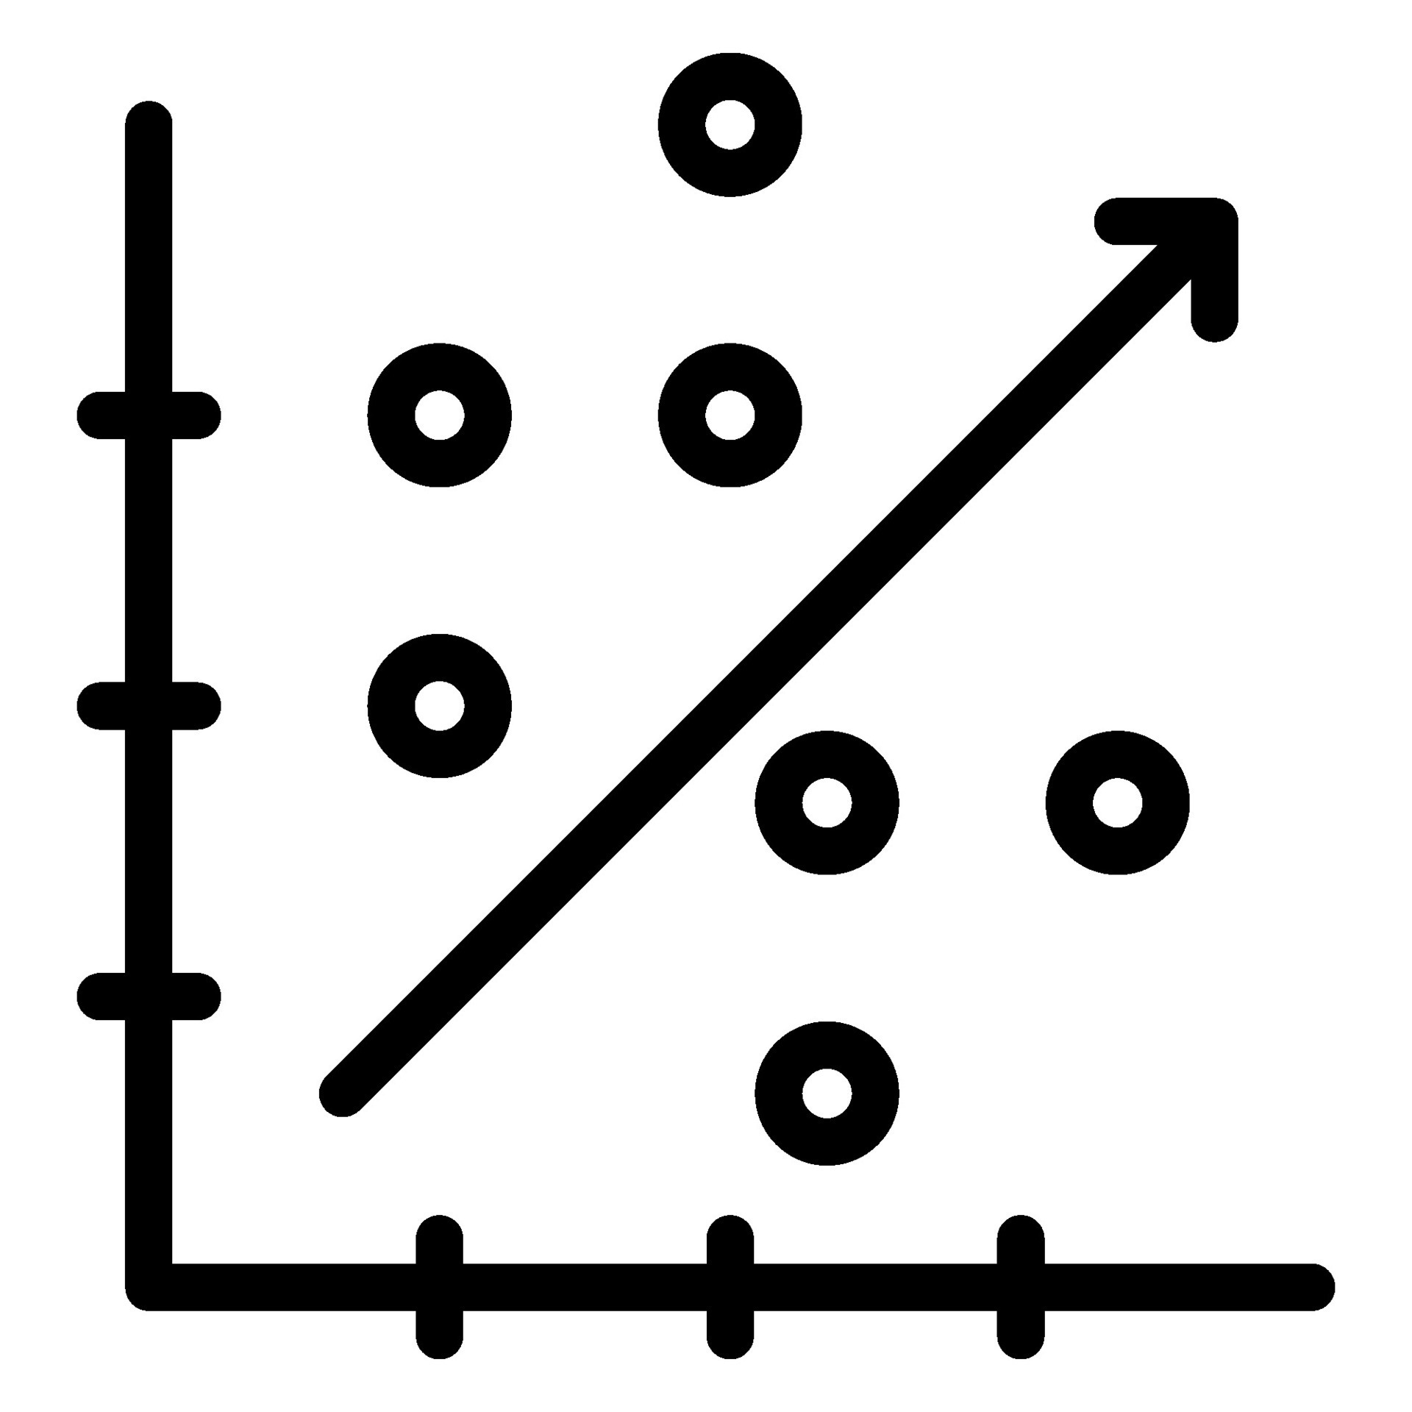
Model Selection
Linear
Regression
Notes:
First, we did a baseline model with Linear regression:
Before we could do linear regression, we had to aggregate data, to reflect weekly unit sales per product, filter the data to make all data used more relevant to our specific question.

Slide 9
Model Selection
Linear
Regression
R² = 0.86
Lack of similar products in data
Notes:
We then predicted on 7 variables with low correlation to get an r-squared of .86.
We faced some issues regarding this model. One was how to apply it to our specific question. We made a test set to reflect the weeks we were predicting for. However, there were only a few similar products that resembled what our product looked like and this model would give predictions very close to the historicals of those few.

Slide 10
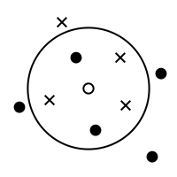
Model Selection
Linear
Regression
k-Nearest
Neighbor
R² = 0.86
R² = 0.87
Lack of similar products in data
Volatile outcomes depending on hyperparameters
Notes:
Second, we tried k-nearest neighbor. Using the four nearest neighbors and weighted averages, this model tested .87 for R-squared using the same data as for linear regression. The issues with this model was that the prediction outcomes dependent a lot on how many neighbors that were used, whether it was weighted or not and what distance metric we used.

Slide 11

Model Selection
Linear
Regression
k-Nearest
Neighbor
Decision Trees
R² = 0.86
R² = 0.87
R² = 0.84
Lack of similar products in data
Volatile outcomes depending on hyperparameters
Lack of similar products in data
Notes:
Third, we used rpart for decision trees using the same data as the previous two. The R-squared was lower, and we found the much like the linear regression, this model model did not have enough similar products to get good results for the specific product.

Slide 12

Model Selection
Linear
Regression
k-Nearest
Neighbor
Decision Trees
Time Series
R² = 0.86
R² = 0.87
R² = 0.84
R² = 0.94
Lack of similar products in data
Volatile outcomes depending on hyperparameters
Lack of similar products in data
Requires data filtering for similar products
Notes:
Lastly we did time series with ARIMA. We sorted the data by week and year, aggregated quantity by weeks and filtered data by package, category and manufacturer to replicate the product we are predicting for. This model gave us the best results and was also the easiest to interpret. One of the main concerns with this model was how much to filter the data and how much we should generalize it.

Slide 13
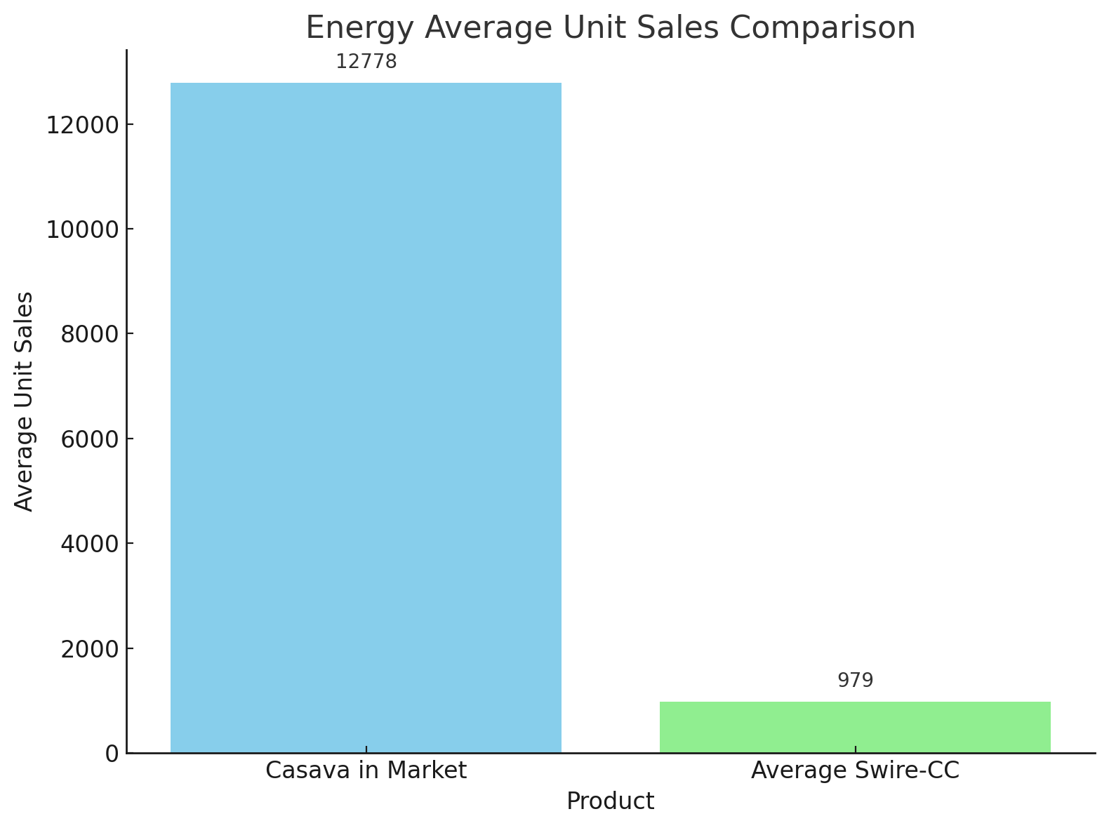
Model Considerations
Focused on one product for demand conversions
Market with Cassava was about 13x higher than Swire-CC
One 2L-jug sale for every 1.7 units of 16-Small sold
Flavor derivation: lack of specific data meant this couldn’t be applied

Slide 14
Additional Modeling Conditions
Expected CAGR: 8.1% *
Launch period: First 26 weeks
Other assumptions
Market growth applies to Swire-CC
Market demand ratio applies to Swire-CC
* https://finance.yahoo.com/news/united-states-energy-drink-market-223000902.html?guccounter=1
Notes:
https://finance.yahoo.com/news/united-states-energy-drink-market-223000902.html?guccounter=1

Slide 15
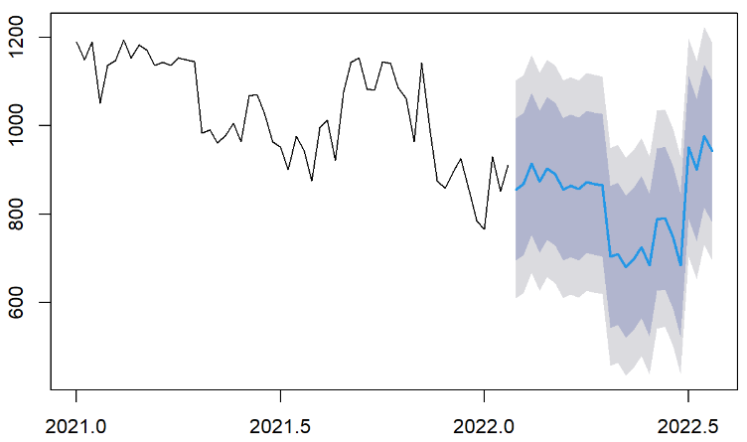
Penalty of Incorrect Prediction
Nominally predictive value is only optimal if overage costs and underage costs are equivalent
Unit Sales
Time

Slide 16
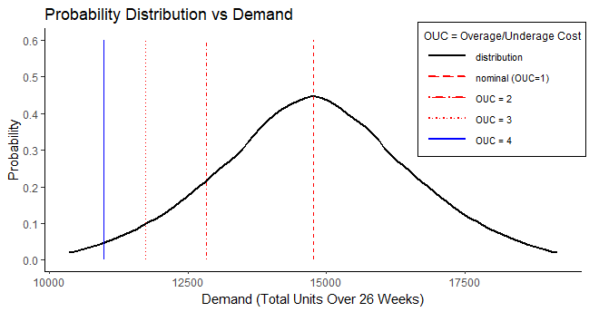
Penalty of Incorrect Prediction
Nominally predictive value is only optimal if overage costs and underage costs are equivalent

Slide 17
Penalty of Incorrect Prediction
Nominally predictive value is only optimal if overage costs and underage costs are equivalent
Demand Prediction | 15,000 units
Production Recommendation | 11,000 units

Slide 18
Recommendations and Future Work
Our recommendation for 6-month demand of Diet Energy Moonlit Cassava 2L Multi Jug is 11,000 units

Slide 19

Recommendations and Future Work
Our recommendation for 6-month demand of Diet Energy Moonlit Cassava 2L Multi Jug is 11,000 units
We believe that additional information about the marketing budget should be included into the prediction

Slide 20

Recommendations and Future Work
Our recommendation for 6-month demand of Diet Energy Moonlit Cassava 2L Multi Jug is 11,000 units
We believe that additional information about the marketing budget should be included into the prediction
Use confidence intervals to balance predicted demand vs recommended production

Slide 21

Recommendations and Future Work
Our recommendation for 6-month demand of Diet Energy Moonlit Cassava 2L Multi Jug is 11,000 units
We believe that additional information about the marketing budget should be included into the prediction
Use confidence intervals to balance predicted demand vs recommended production
Lastly, every business analyst’s dream: MORE DATA

Slide 22
Questions?
Group 1
Louis Ackumey
Gustav Vollo
Shane Nisley
Aiden Coutin

